Slide 1
Our Transformation
Rosalind Radcliffe, Chief Architect for DevOps for Enterprise Systems
IBM Distinguished Engineer
rradclif@us.ibm.com
@RosalindRad

Slide 2
Our Goal
Bring a set of products together in a single development process for simplified customer use
Simplified portal to get the right parts for the right users
Faster delivery of capability across the product stack – monthly releases for all products

Slide 3
What we had
Separate development teams – with their own process and tools
Separate release deliverables
Separate schedules – varying releases months to year+
These products represent all the modern IDEs for the z/OS product stack – z/OS explorer is provided for all z/OS Customers
A few products had clients that needed to integrate but remain separate development processes
ADF for z Systems
CICS Performance Analyzer
IBM Application Discovery
IBM Developer for z Systems
CICS Configuration Manager
Rational Team Concert
Fault Analyzer for z/OS
CICS Interdependency Analyzer
z/OS Connect EE
File Manager for z/OS
CICS Deployment Assistant
IMS Explorer
App Performance Analyzer
CICS Transaction Gateway
MQ Explorer
CICS Explorer
Data Studio
z/OS Explorer

Slide 4
What we did
Single pipeline for all development teams
Automated testing framework
Stopped development other than critical PRMs to build automated tests
Added products a few at a time to add the product, and the team into the “environment” and culture

Slide 5

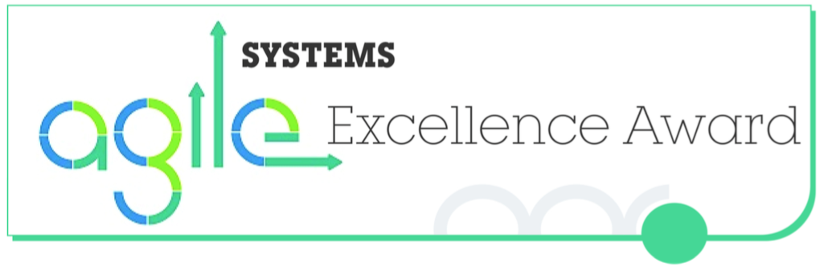


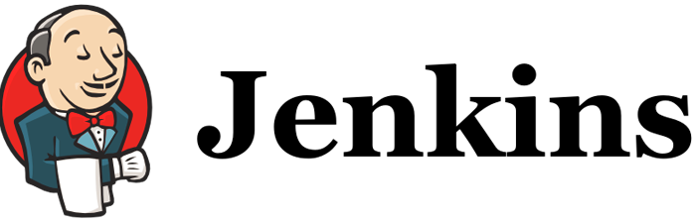


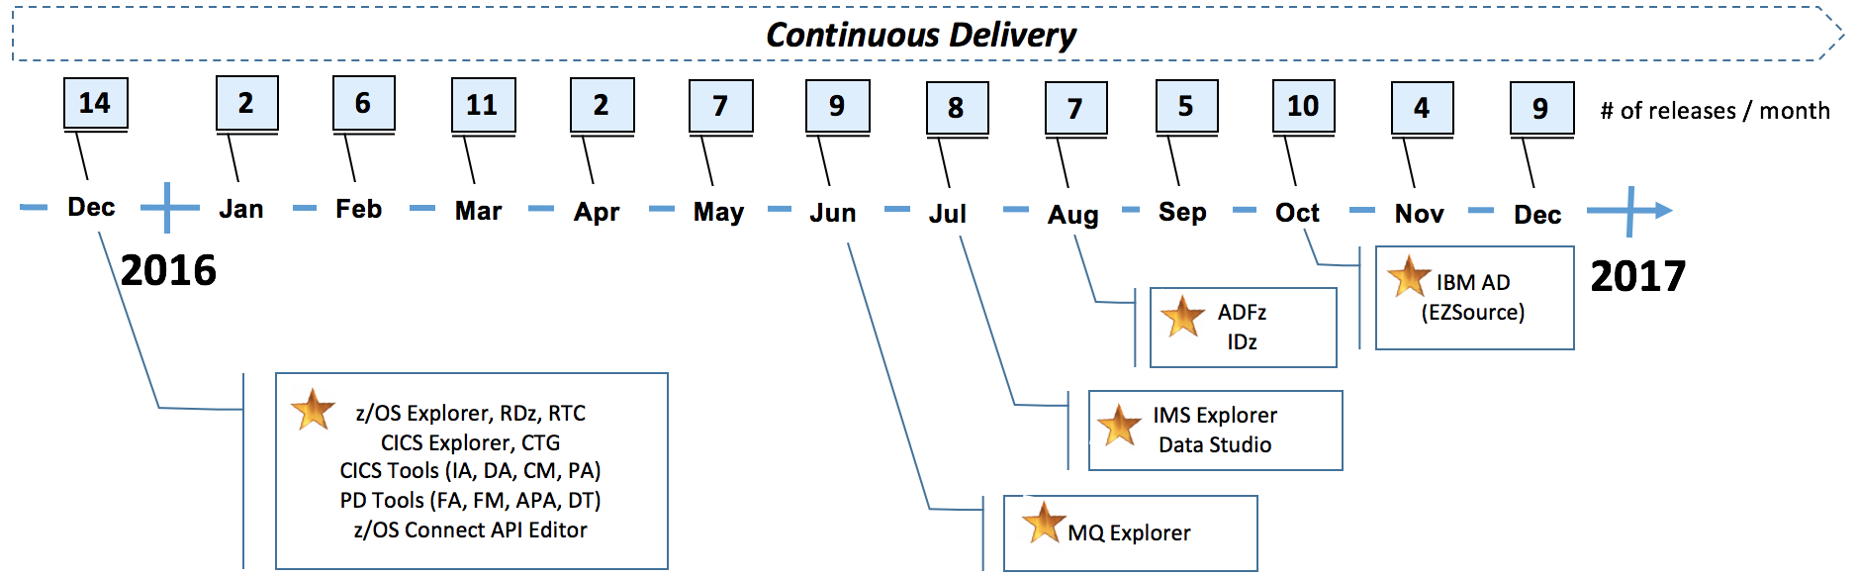
IBM Explorer for z/OS Aqua 2016
4Q 2016
ADF for z Systems
CICS Performance Analyzer
IBM Application Discovery
IBM Developer for z Systems
CICS Configuration Manager
Rational Team Concert
Fault Analyzer for z/OS
CICS Interdependency Analyzer
z/OS Connect EE
Facts & Figures
94 releases, 17 products, 13 deploys
Major Release: 12-18 to 3-5 mths
FixPak: 4-6 mths to 1 mth
30% build time improvement
80% deploy time improvement
Single build, test, deploy infrastructure
Single product repository
Single customer-facing dW site
File Manager for z/OS
CICS Deployment Assistant
IMS Explorer
App Performance Analyzer
CICS Transaction Gateway
MQ Explorer
CICS Explorer
Data Studio
Common Integration Platform
z/OS Explorer
Eclipse
Delivered!
IBM z Systems Continuous Integration & Delivery

Slide 6
Critical success factors
Learned from those that had already transitioned
CICS team started in 2005 with transition
Spent the time to work across teams
Appropriate retrospectives to improve process and improve team collaboration
Management support for time to improve

Slide 7
CICS end-to-end DevOps Development
Applying Design Thinking and Continuous Integration
Playback the plan for new CICS function to stakeholders
Agile approach
Continuous
Integration
Release new CICS function to market
Review CICS stake holder requirements
CICS Design Partnership Forum
Frequent, early feedback
Over 30 major CICS customers attending weekly
playbacks
CICS Offering Management
Assessing the market need all year round
Refine
Agile Teams
Multi-disciplined
Self organised
Trusted
Accept change
Iterative development
Agile Artefacts
Epics
Stories/Story Pts
Burn down
Prioritised backlogs
Weekly
Playbacks
To stake-holders
CICS Continuous Delivery
New function delivered quarterly
Automated Pipeline
Fully automated Build, Deploy, Test
Continuous Integration of new code
Modern plug-in based tooling – all tools integrate enabling extensive automation
Reliable, high quality automated test cases
A Beta build every day – enables early demonstration of working code

Slide 8
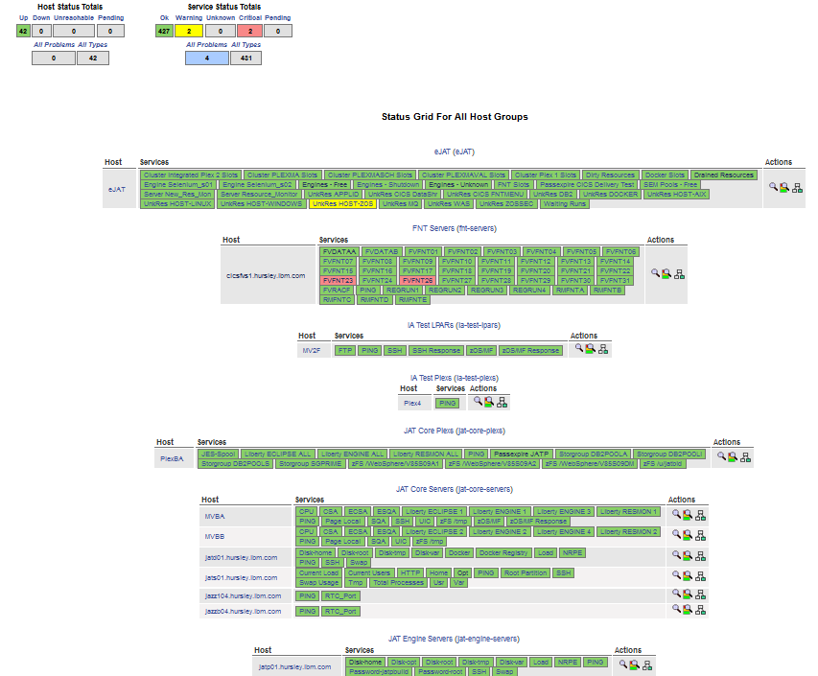
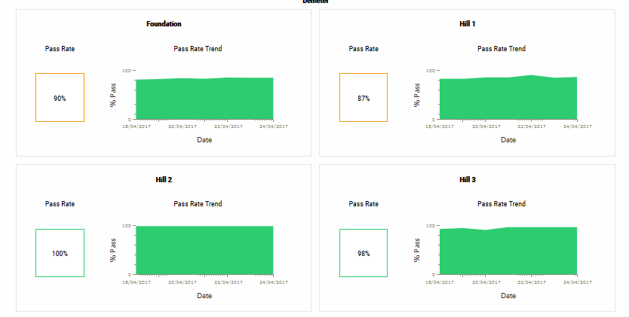
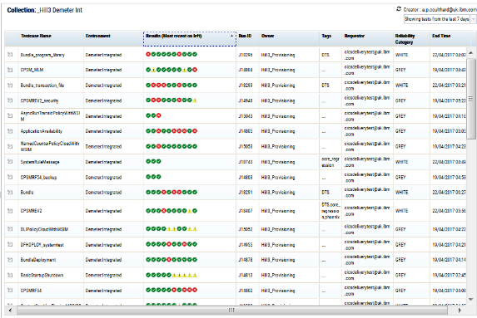
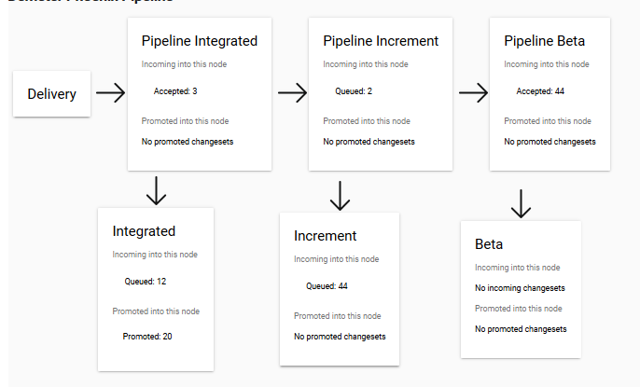
Continuous Integration working for CICS on zOS
Shift Left
Automated Acceptance into the Build Stream
Automated Build, Deploy, Test
Reporting of Test Results
Monitoring dev/build/test Systems
On Demand locally build, deploy, validate new code.
Parallel testing on zOS enables rapid feedback to developers (< 30minutes)
Defects identified and resolved before entering pipeline
Extensive monitoring of systems ensures highly reliable dev/test systems
Essential for Continuous Integration
Continuous Integration
Every 30 minutes Jenkins ‘pulls’ code into the build pipeline only if ‘shift left’ tests pass.
REJECT code that is breaking build/tests.
High quality, extensive automated regression test applications
High pass rate as ‘shift left’ prevented promotion of bad code
Priority given to resolving pipeline failures (rare)
‘Beta quality’ builds created daily
Enables early stakeholder feedback - essential for Agile
Automated provisioning of complex test
environments

Slide 9
Additional support for teams
Developed a CI/CD Community to share best practices
Slack channel for communication
Specific slack channels for support of parts of the tool chain
Golden Topology for traditional z/OS products

Slide 10
Quotes from the teams
A network of 30 change leaders from 16 z System products have identified a golden topology of tools to implement agile build/test processes. The tools are designed to integrate, enabling extensive automation for fast and cost effective build/test.
"Using UrbanCode to deploy test systems has reduced the time to install each server from 3 days down to 30 minutes, and for our component, from 1.5 days down to just 10 minutes! With UCD's scheduling capability, multiple servers are updated at 2 am every morning leaving systems ready for testing by 2:10 am. This massive improvement in efficiency, repeatability, and automation brings developers meaningful testing feedback far earlier in the process."
CICS has automated its testing of doc builds (using JAT). Tests validate the installation and web links of 38 collections of doc across 10 platforms. Testing of just one collection on 4 platforms is reduced from 2 days to 20 minutes.
For increased agility, CICS has built an automated, plug-in based test framework (JAT) that integrates with RTC, Jenkins, UrbanCode Deploy etc. Designed as non-product specific, JAT is now used by 6 products with a further 6 prototyping/interested.
CICS Operational Insights ("OI") is an experimental Z Systems SaaS offering that is Continuously Delivering new capability. CICS OI has built a best of breed Continuous Delivery pipeline using RTC, Jenkins and Docker that enables the team to rapidly extend and test the offering whilst ensuring existing capability remains functional.

Slide 11
Here’s the help I am looking for
Development teams still believe DevOps does not apply to traditional z/OS applications or Systems of Record – everyone needs to help push this cultural change
Two Speed IT is still talked about – two speed IT does not work, and there is no reason Systems of Record can’t move as fast

Slide 12
Mainframe DevOps
The Compuware Story
David Rizzo Vice President of Product Development
June 2017

Slide 13

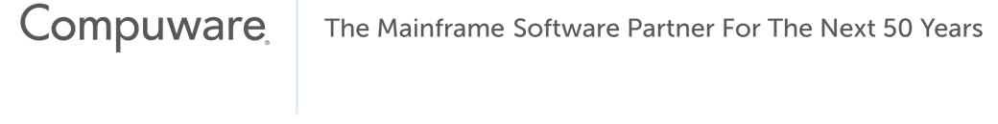
Recognizing There Is a Problem

Slide 14

40 Years of Waterfall

Slide 15

Slow-moving Development

Slide 16

In the Modern Digital Economy—Fast Beats Slow

Slide 17

Innovation Ideation Is Key to Success

Slide 18

Quality Measure, Maintain and Improve

Slide 19

Define the Desired State and How to Get There

Slide 20
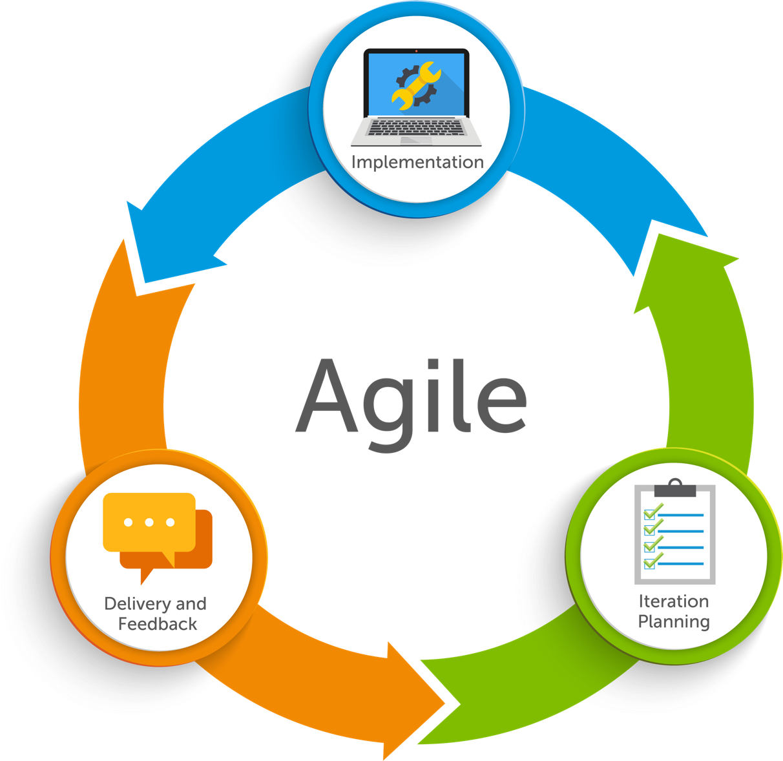
Agility Frequent, Rightsized Code Changes to Fulfill Business Needs

Slide 21
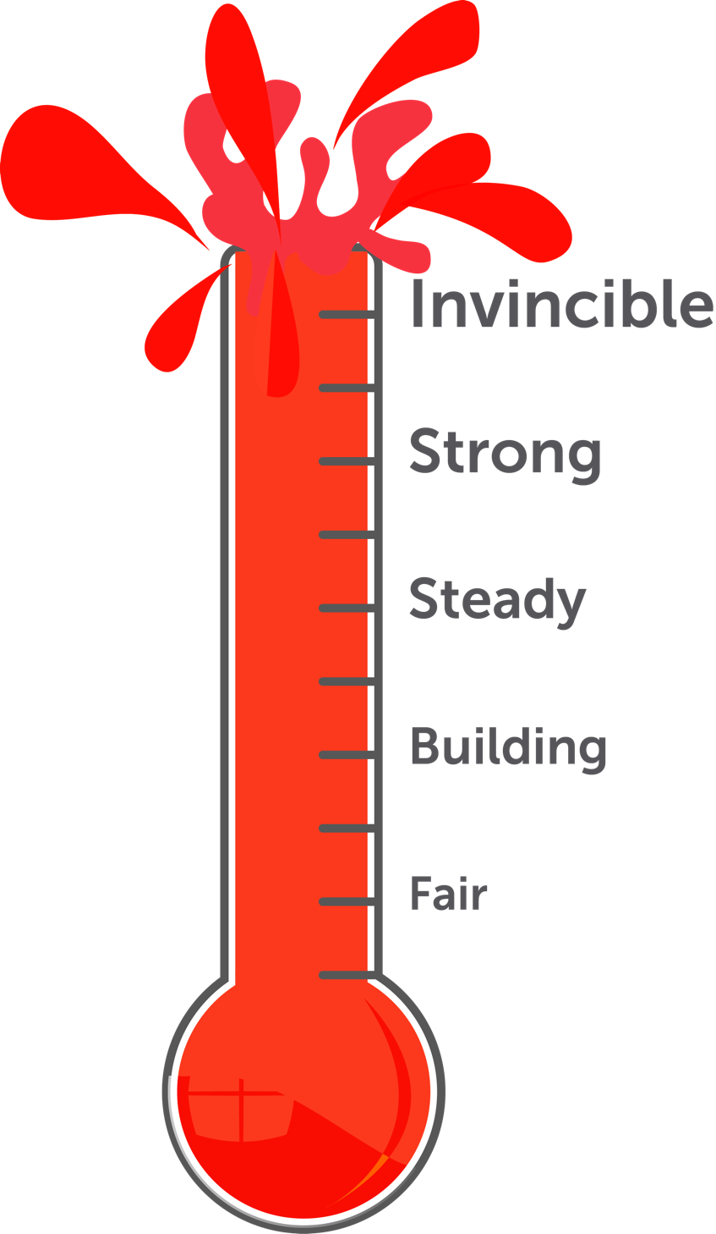
Confidence Ensures Successful Mainframe Code Changes Without Unintended Consequences

Slide 22
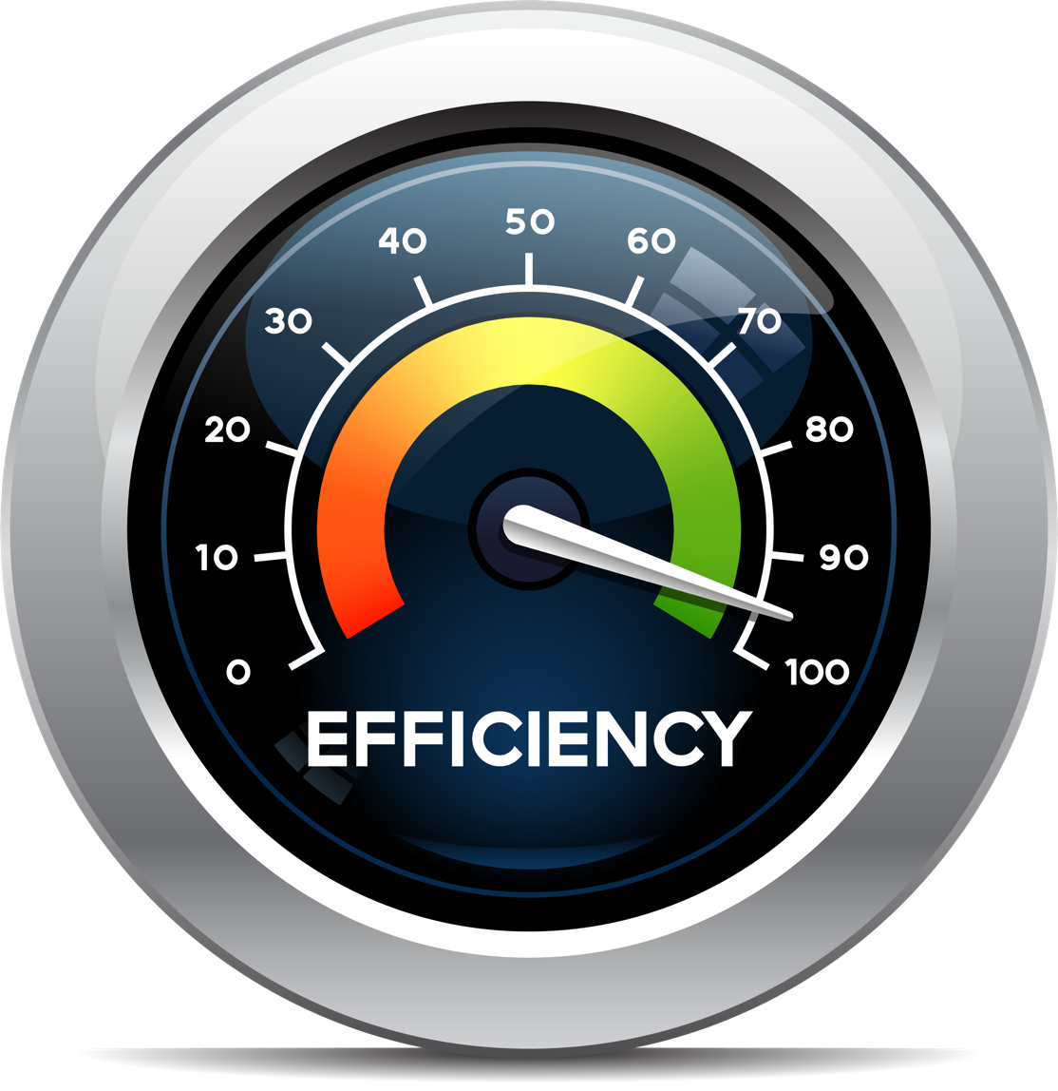
Efficiency – Maximizes time and skills across development, testing and operations
Efficiency Maximizes Time and Skills Across Dev, Test and Ops

Slide 23

Ease of Use Empowers Mainframe-inexperienced Devs to Work on Updates and Enhancements

Slide 24
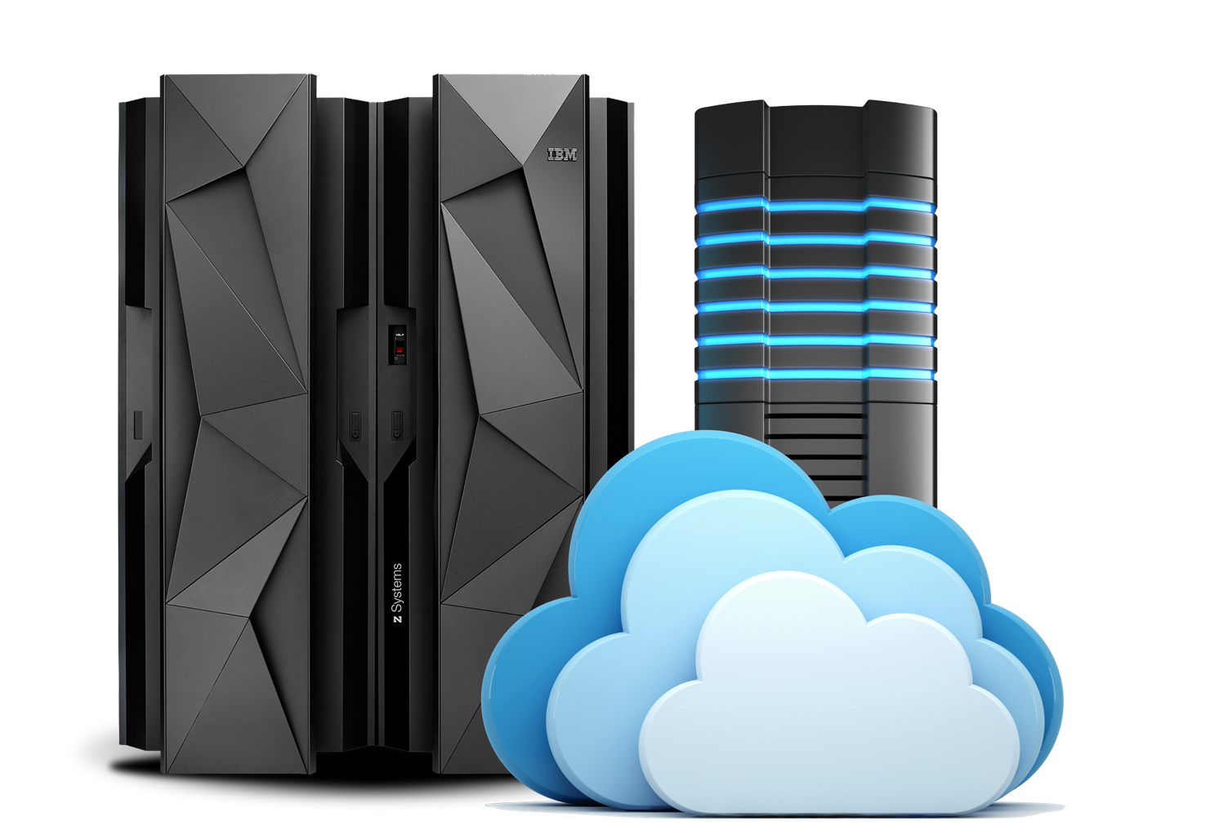
Integrations Connect Mainframe and Non-mainframe Systems to Achieve DevOps

Slide 25


The Right Tools Make It All Happen
Verified Software Toolchain

Slide 26
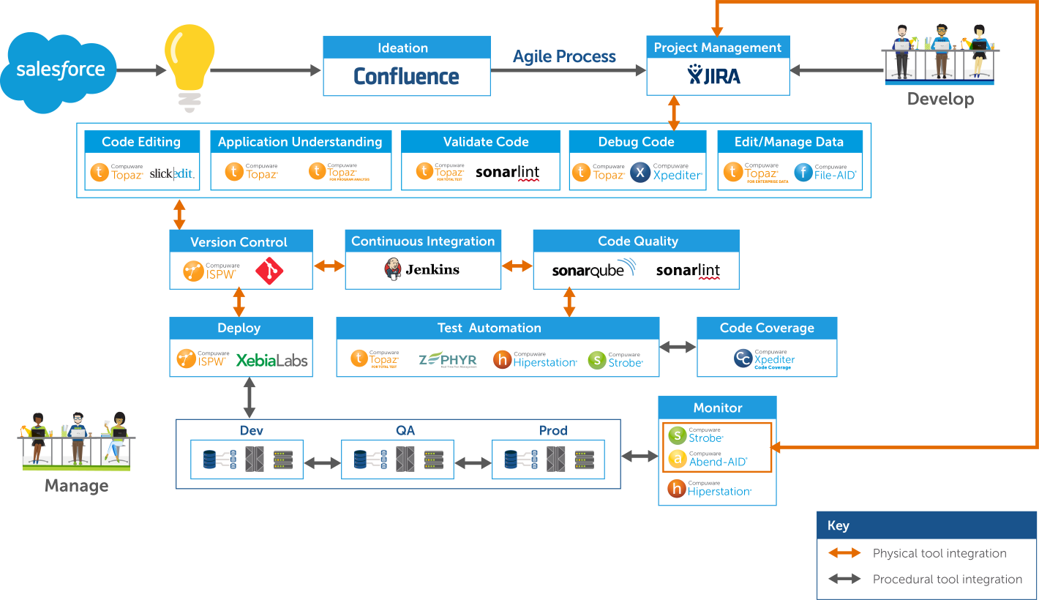
Compuware DevOps Toolchain

Slide 27

Metrics that Matter

Slide 28
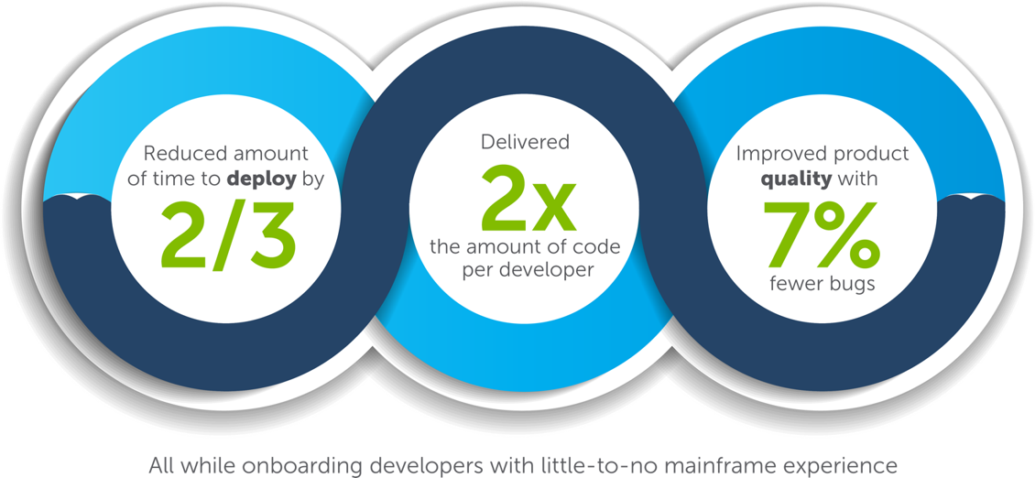
Compuware Case Study*
Speed and Quality Through DevOps and Agile Development
*YOY results

Slide 29

What We’ve Done

Slide 30
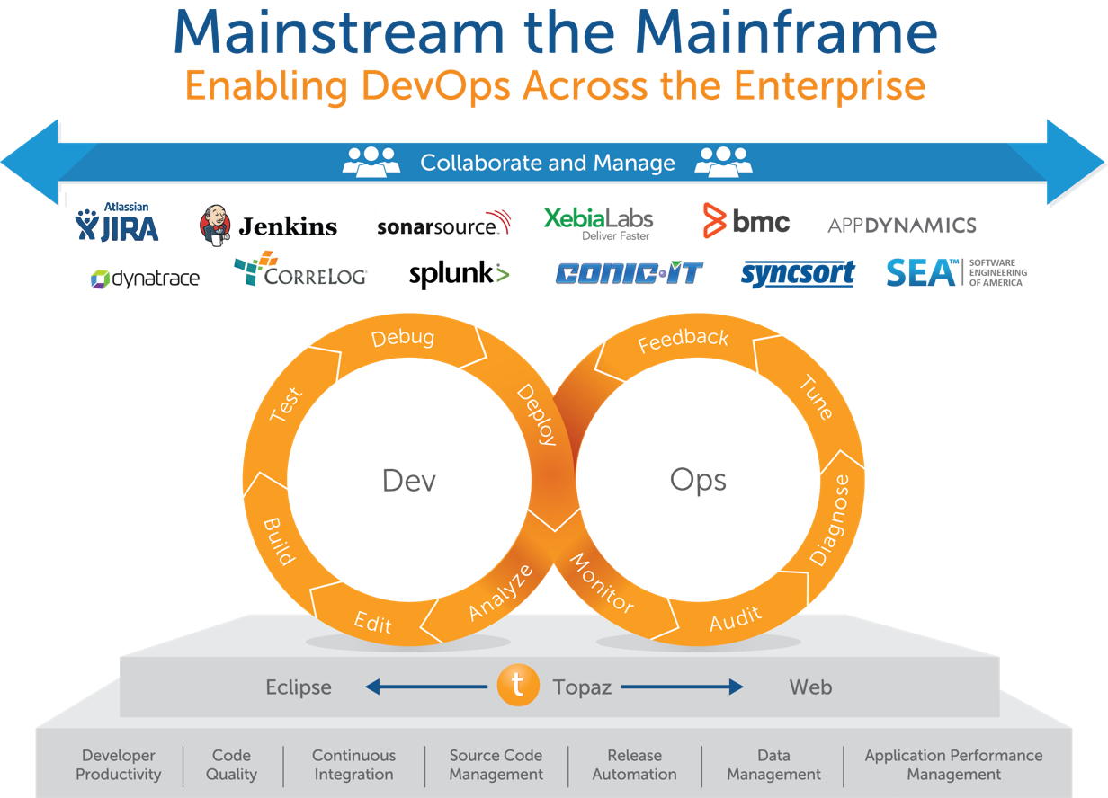

Slide 31
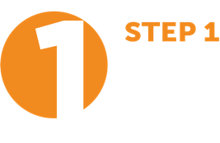
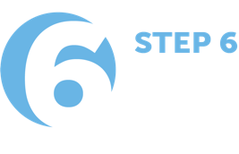
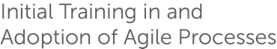
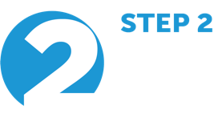

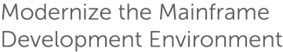
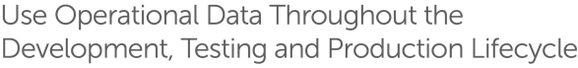
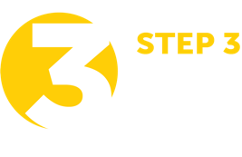
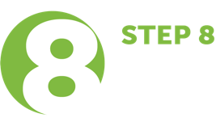
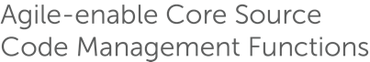
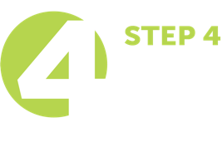
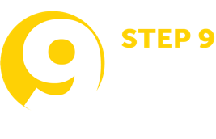

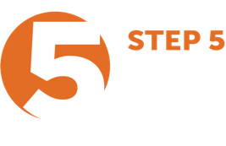

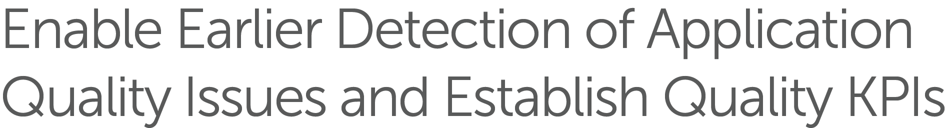
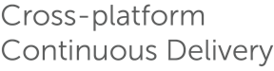

10 Steps to Mainframe Agile Development

Slide 32


Questions
David.Rizzo@compuware.com
Twitter: @dfrizzo1

